Slide 1
CURRENT TRENDS IN LITHIUM ION BATTERIES
PRESENTED BY
NIKHIL CHOWDARY
BALAJI
RAVI CHANDRA
MANYATHA
SUSMITHA

Slide 2
COMPONENTS OF LITHIUM ION BATTERY
The lithium-ion cell consists of:
1.Negative electrode (Anode)
2.Positive electrode (Cathode)
3.Electrolyte
4.Separator
5.Current collectors.

Slide 3
INTRODUCTION
Lithium-ion batteries (LIBs) are a popular type of rechargeable batteries known for their high energy density, making them a staple in numerous electronic devices. These batteries are composed of various materials that facilitate the movement of lithium ions between the positive and negative electrodes, enabling the storage and release of energy.
The inception of lithium-ion batteries dates back to the 1970s, but significant advancements in their technology have been witnessed over the years, leading to increased efficiency, longer lifespan, and improved safety measures.

Slide 4
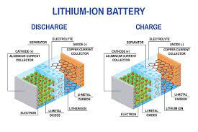
WORKING OF A LITHIUM ION CELL
While the battery is discharging and providing an electric current, the anode releases lithium ions to the cathode, generating a flow of electrons from one side to the other. When plugging in the device, the opposite happens: Lithium ions are released by the cathode and received by the anode.

Slide 5
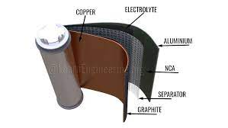
APPLICATIONS OF LITHIUM ION CELL
Defense
Aerospace
Instrumentation
Oil drilling
Mobile phones
Laptops
Power tools
Electric powertrain

Slide 6
ADVANTAGES AND DISADVANTAGES
Advantages :
Lithium-ion cell has self-discharge very slow.
The energy efficiency of the lithium-ion cell is 80%.
Rechargeable batteries.
Low maintenance
Disadvantages:
The cost of lithium cells is very high.
The battery management system is required.
Sensitive to overcharge leads to exposure.

Slide 7
CONCLUSION
Lithium-ion batteries provide a reliable and high-energy-density power source for various applications, including smartphones, electric vehicles, and renewable energy storage. Their key features include long cycle life, lightweight design, and high efficiency. However, they can experience issues such as capacity degradation over time and safety concerns like overheating. Continuous research aims to improve performance, safety, and sustainability in lithium-ion battery technology.
Lithium-ion batteries are widely used in industrial settings for powering laptops, tablets, cordless tools, and other portable electronic devices.
Lithium-ion batteries are utilized in industrial-scale energy storage systems to store excess energy generated from renewable sources such as solar and wind. This helps balance supply and demand in power grids.
Many medical devices, such as portable medical equipment and implantable devices, use lithium-ion batteries for their compact size, energy density, and rechargeable capability.

